Slide 1
KIGALI INDEPENDENT UNIVERSITY(ULK)
Module: Computer architecture and hardware maintenance
Module code: CSM107
Lecturer : Kwizera Jean Pierre
Cell phone : 0785520535
E-mail : kwijpeter01@gmail.com

Slide 2

Aim of the module
The aim is to present as clearly and completely as possible, the nature and characteristics of modern-day computer systems.
Introduces the basic concepts of Computer Architecture and Compute maintenance.
The structure of sub systems and covers the organization of the overall system
Outlines the fundamental way in which a computer works

Slide 3
INTRODUCTION
Computer architecture deals with the design of computers, data storage devices, and networking components that store and run programs, transmit data, and drive interactions between computers, across networks, and with users.
Computer architectures represent the means of interconnectivity for a computer's hardware components as well as the mode of data transfer and processing exhibited.
Example: The mode of transferring information between internal storage and external I/O devices is known as I/O interface or input/output interface.

Slide 4
Computer hardware maintenance involves taking care of the computer's physical components, such as its keyboard, hard drive and internal CD or DVD drives.
Maintenance of computer hardware is a way of taking care, repairing and replacing broken and failing computer hardware.
Hardware Maintenance means repairs, upgrades, or installation of hardware required for the hardware to continue to operate as originally specified in the contract or purchase order.

Slide 5

Course outline:
Chapter 1: Hardware introduction
Chapter 2: Computer architecture
Chapter 3: Microprocessor
Chapter 4: Semiconductor and Secondary memory
Chapter 5: Introduction to digital logic

Slide 6
Chapter 1: HARDWARE INTRODUCTION

Slide 7
Introduction to Computer Hardware
A computer is an electronic device, operating under the control of instructions stored in its own memory that can accept data (input), process the data according to specified rules, produce information (output), and store the information for future use.
In essence, a computer is a machine designed to process, store, and retrieve data.
Data may be numbers in a spreadsheet, characters of text in a document, dots of color in an image, waveforms of sound, or the state of some system, such as an air conditioner.

Slide 8
The computer manipulates the data by performing operations on the numbers. Displaying an image on a screen is accomplished by moving an array of numbers to the video memory, each number representing a pixel of color.
Data: it is the collection of raw facts, figures and symbols
E g: Names of students and their marks in different subjects listed in random order.
Information: it is the data that is processed and presented in an organized manner.

Slide 9
FUNCTIONALITIES OF A COMPUTER
Step 1 − Takes data as input.
Step 2 − Stores the data/instructions in its memory and uses them as required.
Step 3 − Processes the data and converts it into useful information.
Step 4 − Generates the output.

Slide 10
Summary.
The functions of a computer typically include the following tasks:
taking data
processing it,
returning results, and
storing it.
To help computer systems perform these functions, computer devices can be classified as:
input devices,
processing devices,
output devices, and
storage devices, respectively.

Slide 11
Anatomy of Computers
The computer system consists of three main units:
1. Input device
2. Central Processing Unit (CPU)
3. Output device

Slide 12
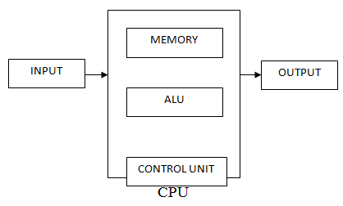
Anatomy of Computers: the building block of a computer
Block diagram of a Computer:

Slide 13
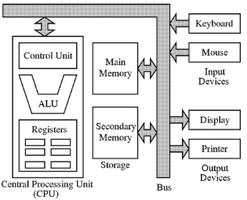
Anatomy of Computers

Slide 14
Anatomy of Computers
1. Input device: Reads information from input media and enters to the computer in a coded form.
2. CPU
(a) Memory unit: Stores program and data
(b) Arithmetic Logic unit: Performs arithmetic and logical functions.
(c) Control Unit: Interprets program instructions and controls the input and output devices.
3. Output device: decodes information and presents it to the user.

Slide 15
Anatomy of Computers
Input Devices
Keyboard: the Keyboard is used for typing text, numbers into the computer. It is also known as standard Input device.
The AZERTY keyboard (French) because the layout of the first six letters on the keyboard is: A.Z.E.R.T.Y
The QWERTY keyboard (English) because the layout of the first six letters on the keyboard. Q.W.E.R.T.Y

Slide 16
Anatomy of Computers
Input Devices
Mouse: It is a device that controls the movement of the cursor on a monitor.
A mouse will have 2 buttons on its top.
The left button is the most frequently used button.

Slide 17
Anatomy of Computers
Output Devices
Monitor: The screen that shows the information for the computer.
Printer: A printer is used to transfer data from a computer onto paper.

Slide 18
Anatomy of Computers
Computer Memory (primary memory)
RAM: The main type of memory and the most familiar to users is random access memory (RAM). RAM is the same as main memory. A computer can both write data into RAM and read data from RAM.
RAM is volatile, which means that it requires a steady flow of electricity to maintain its contents.

Slide 19
Anatomy of Computers
Computer Memory (primary memory)
ROM (read only memory): unlike RAM, ROM is non-volatile and only permits the user to read data.
It is called Read-only memory as information can only be read from and not written or changed onto ROM.

Slide 20
Anatomy of Computers
Computer Memory (secondary memory)
The primary memory which is faster (and hence expensive) is generally not sufficient for large storage of data.
As a result, additional memory, called the auxiliary or secondary memory is used.

Slide 21
Anatomy of Computers
Computer Memory (secondary memory)
It is also referred as backup storage as it is used to store large volume of data on a permanent basis which can be transferred to the primary memory whenever required for processing.

Slide 22
Anatomy of Computers
Computer Memory (secondary memory)
Hard Disk, CD-ROM, DVD and Flash
The main circuit board of a computer is also known as the motherboard.
Typically, the motherboard contains the CPU, memory and basic controllers for the system.

Slide 23
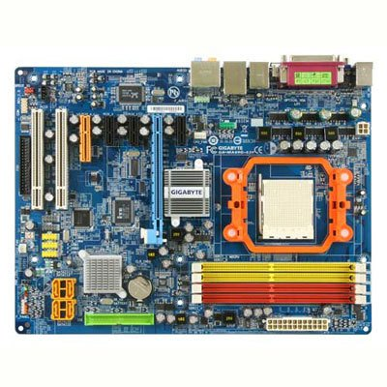

Slide 24
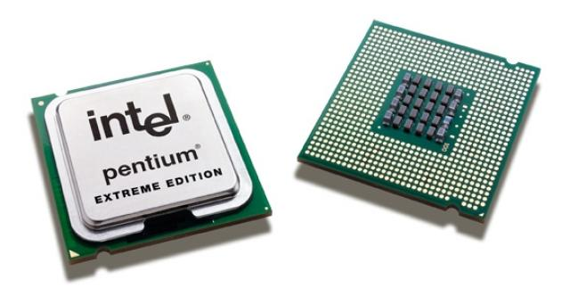

Slide 25
Advantages of Using Computers
Large Storage Capacity: Computers can store large amount of information. Any item of data or any instruction stored in the memory can be retrieved by the computer at lightning speeds
Superior Speed of Operation: Computers have the ability to perform routine tasks at a greater speed than human beings. They can perform millions of calculations in seconds
High Accuracy: Computers are used to perform tasks in a way that ensures accuracy.
Cost effectiveness: Computers reduce the amount of paper work and human effort, thereby reducing costs.

Slide 26
Advantages of Using Computers
Automation: Computers can be instructed to perform complex tasks automatically (which increases the productivity).
Diligence : Diligence is the capacity of the computer of performing repetitive tasks without getting tired.
Computers can perform the same task repeatedly & with the same accuracy without getting tired
Versatility: refers to the ability of computers to perform a variety of tasks . Computers are flexible to perform both simple and complex tasks.

Slide 27
Disadvantages of Using Computers
Health Risks, prolonged or improper computer use can lead to head injuries or disorders. Computer users can protect themselves from health risks through proper workplace design, good posture while at the computer, and appropriately spaced work breaks.
Violation of Privacy, it is crucial that personal and confidential records stored in computers be protected by computers.
Impact on Labour Force, although computers have improved productivity and created an entire industry with hundreds of thousands of new jobs, the skills of hundreds of thousands employees are replaced by computers.
Computers can make the mind lazy, you get used to not reading a book, or researching something at the library.

Slide 28
Disadvantages of Using Computers
More Screen time may affect your eye eyesight
Lack of common sense: Computer is only an electronic device. It cannot think.
Computers affect on our society. Wasted time on the computer.
Unemployment is increasing

Slide 29
Computer limitations
Computers need clear & complete instructions to perform a task accurately. If the instructions are not clear & complete, the computer will not produce the required result.
Computers cannot think.
Computers cannot learn by experience.

Slide 30
SYSTEM BUSES
System buses
The system bus is one of the most important components of a computer system. Its main function is to facilitate data communication between the system's parts.
A system bus is a set of electrical wires that connects major components (CPU, memory and I/O devices) of a computer system.

Slide 31
A bus is a set of electrical wires (lines) that connects the various hardware components of a computer system.
It works as a communication pathway through which information flows from one hardware component to the other hardware component.
What is Computer Bus: The electrically conducting path along which data is transmitted inside any digital electronic device.

Slide 32
How does a system bus work?
A system bus works by sharing data and other information between various aspects of the computer's hardware.
For example, if you plug a universal serial bus (USB) device or connector into your computer, the system bus recognizes that data and takes it to the computer's central processing unit.
The basic functions of a system bus include:
a) Internal function: Also known as a memory bus, an internal system bus connects the hardware that's inside the computer to local devices within the computer's system.
b) External function: Also known as an expansion bus, an external system bus uses electronic pathways that connect primarily to external devices outside the computer's system.
For example, connecting your computer to a wireless printer or mouse makes use of an external system bus.

Slide 33
NB:
The Internal Bus connects the different components inside the case such as the CPU, system memory, and all other components on the motherboard. It's also referred to as the System Bus.
The External Bus connects the different external devices, peripherals, expansion slots, I/O ports and drive connections to the rest of the computer.
In other words, the External Bus allows various devices to be added to the computer.
Another name for the External Bus is the Expansion Bus.

Slide 34
c) Data sharing: The main function of a system bus is to transfer data from one place to another using a parallel structure, and the amount of data shared at one time depends on the size of the system bus.
For example, the computer systems of a large corporation might have higher data sharing capabilities than that of a home computer.
d) Addressing: This function allows users to transfer information about certain data between locations in the computer's main memory. It alerts the system to where to take certain pieces of data.
e) Power: This function supplies power to each of the various devices connected to the main computer system. It helps the computer's system bus operate at an appropriate speed.

Slide 35
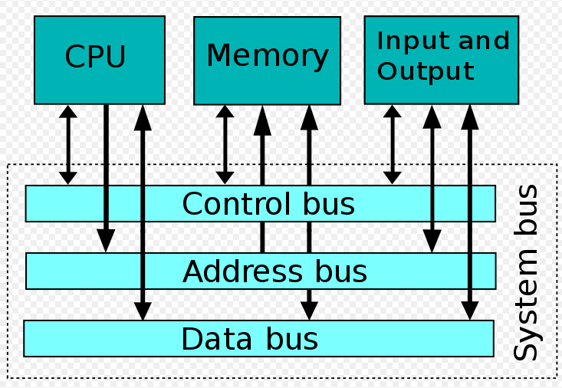
The system bus combines the functions of a data bus to carry information, an address bus to determine where it should be sent, and a control bus to determine its operation as shown in the figure below.

Slide 36
What types of system bus are there?
There are three types of buses, each operating separately with its own purpose and function, that make up a system bus.
Each type of bus follows a unique set of instructions that contribute to the accurate transfer of data.
These three types include:
Data bus
Address bus
Control bus

Slide 37
Data bus
As the name suggests, data bus is used for transmitting the data / instruction from CPU to memory/IO and vice-versa.
It is bi-directional.
The data bus carries the actual data between the computer's main processor, the memory and all other internal hardware components.
It operates between computer parts or devices to increase the flow of data by transferring data in or out of the CPU or from one device to another.

Slide 38
b) Address bus
As the name suggests, address bus is used to carry address from CPU to memory/IO devices.
It is used to identify the particular location in memory.
It carries the source or destination address of data i.e. where to store or from where to retrieve the data.
It is uni-directional.
The address bus tells the system where data comes from or goes.

Slide 39
c) Control bus
As the name suggests, control bus is used to transfer the control and timing signals from one component to the other component.
The CPU uses control bus to communicate with the devices that are connected to the computer system.
The CPU transmits different types of control signals to the system components.
It is bi-directional.
The control bus determines how the system bus operates by managing the control, timing and coordination of the busses to ensure the data transfers without corruption.

Slide 40
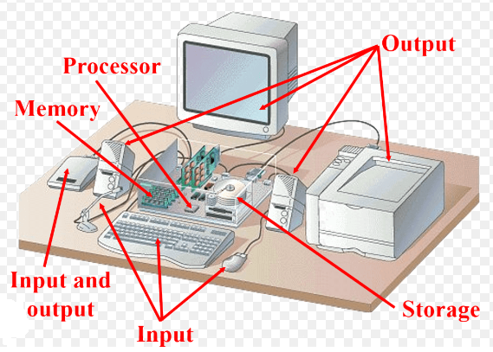
Hardware Components

Slide 41
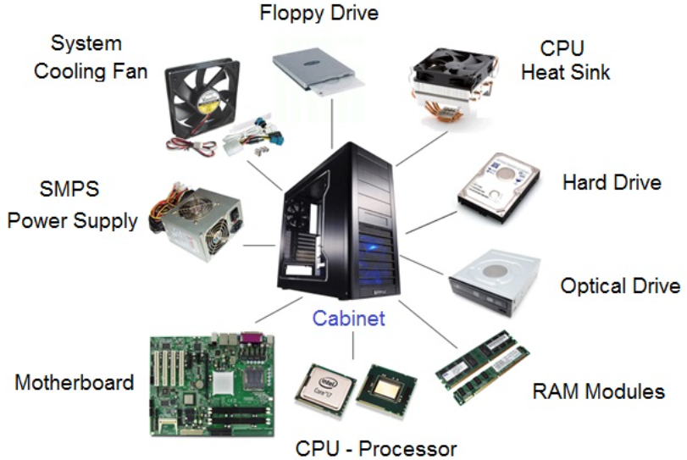

Slide 42
What is a heat sink?
A heat sink is a piece of metal that sits on top of a computer chip such as a CPU and draws power away from components
A CPU is prone to overheating because some of its components product heat. Without the heatsink, the heat generated by the components stay in your CPU, which will burn.
Because most components are made of electronic chips, they absorb heat easily. If they receive too much heat, they become damaged and, therefore, useless, posing a risk to the functionality of high-performance computers.

Slide 43
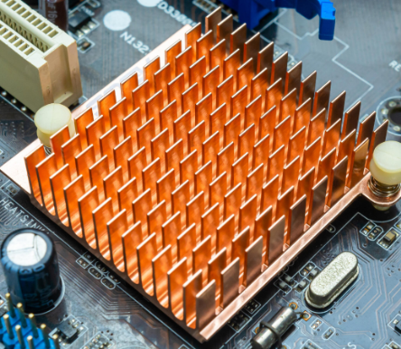
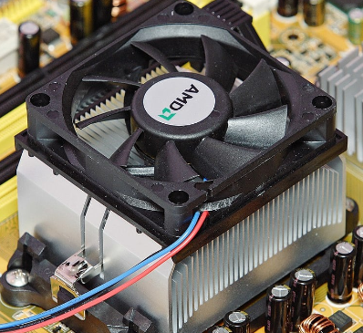
Heat sink System cooling fan
A cooling fan is a vital component in a computer system, that helps takes away all heat absorbed from the component.

Slide 44
Computer cases and power supplies
The computer case and the power supply are two very important parts that help determine the performance of the system.
The type of motherboard used is usually determined by the type of case and power supply.
The power supply is usually included in the computer case.

Slide 45
Computer Cases
The type of case is the first decision when building a computer. The case is made up of the metal chassis (or frame), and a cover, usually constructed of metal or hard plastic.
The case is the housing unit for the internal components and protects against dust and damage.
The case usually comes with the power supply needed to power the computer and the installed components.

Slide 46
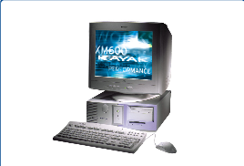
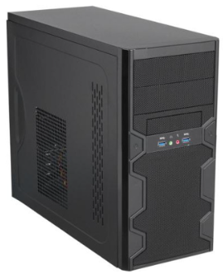
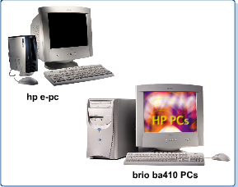
Computer cases are either desktop as shown below,
Desktop computer – a personal computer that is designed to stay at one location and fits on or under a desk. It typically has a monitor, keyboard, mouse, and a tower (system unit)

Slide 47
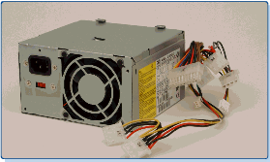
Power Supplies
A power supply unit (PSU) is a hardware device that converts AC electricity into DC electricity and then distributes it to the rest of the computer.
A power supply provides the needed voltage to power the various electronic circuits that make up the PC.
It receives the external AC power.

Slide 48
The motherboard
Knowledge of the motherboard, also called the system board or main board, is crucial because it is the nerve center of the computer system.
The motherboard serves as a single platform to connect all of the parts of a computer together.
It connects the CPU, memory, hard drives, optical drives, video card, sound card, and other ports and expansion cards directly or via cables.
It can be considered as the backbone of a computer.

Slide 49
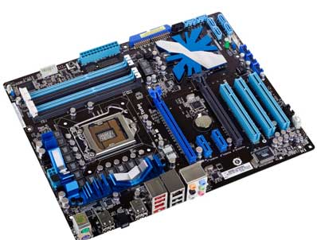
The motherboard

Slide 50
Everything else in the system plugs into it, is controlled by it, or depends on it to communicate with other devices on the system.
The system board is the largest of the printed circuit boards and every system has one.
In addition, it contains the Complementary Metal-Oxide Semiconductor (CMOS) (pronounced C moss), other Read Only memory (ROM), BIOS chips, and support chips providing varied functionality.

Slide 51
Features of Motherboard
A motherboard comes with following features −
Motherboard varies greatly in supporting various types of components.
Motherboard supports a single type of CPU and few types of memories.
Video cards, hard disks, sound cards have to be compatible with the motherboard to function properly.
Motherboards, cases, and power supplies must be compatible to work properly together.

Slide 52
BIOS
The BIOS is the program that starts a computer up, and the CMOS is where the BIOS stores the date, time, and system configuration details it needs to start the computer.
The CMOS battery powers your laptop's BIOS firmware(permanent software programmed into a read-only memory), which is responsible for booting up your computer and configuring data flow.
You can tell if your CMOS battery has died if your laptop has difficult booting up, if drivers disappear, and if your laptop's date and time are incorrect.

Slide 53
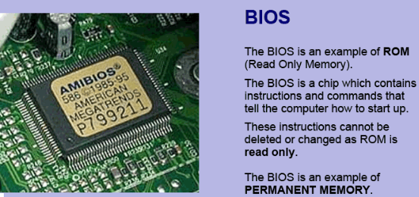
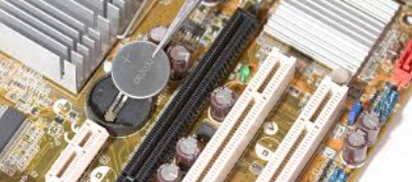
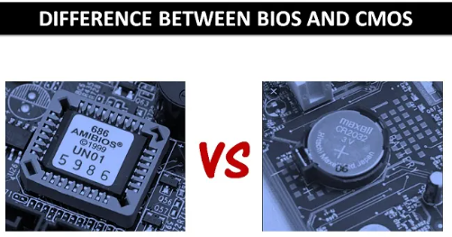
CMOS battery:

Slide 54
What is BIOS?
BIOS implies to Basic Input Output System.
It is a pre-installed program on windows based computer systems.
BIOS is used to start the computers.
BIOS is the first program installed in windows computers even before the operating system.
When we power on a computer, the CPU approaches the BIOS to find out all Input-Output devices and to look over if all hardware connections are properly functioning. BIOS is the one which loads the operating system in to the computer memory, thus completing the booting process.

Slide 55
BIOS is a part of the motherboard.
It is stored in the permanent memory called non-volatile Read-only Memory on the Motherboard of a computer.
Once the booting process is complete, the BIOS acts as an intercessor between the Input-Output devices and the CPU.
All hardware details of the computer are known and managed by the BIOS. Whenever IO device changes, the information needs to be communicated to the BIOS.

Slide 56
What is CMOS?
CMOS technically stands for Complementary Metal-Oxide Semiconductor.
It is a physical portion of the motherboard.
CMOS is a memory chip that holds configuration settings and is supported by the onboard battery called CMOS battery.
Whenever changes are made in BIOS configuration all the changes are stored to CMOS chip.
CMOS is a memory chip which stores the BIOS configuration settings
It holds the date, time and system setup parameters.

Slide 57
FUNCTIONS OF BIOS
POST: test the computer hardware and make sure no errors exist before loading the Operating System
Bootstrap loader: locate the Operating System, if a capable Operating System is located then the control is passed to it
BIOS drivers: these are low level drivers that give computer basic operational control over your computer hardware.
Contains all the code required to control the keyboard, display screen, disk drives, serial ports, etc.
BIOS or CMOS setup: it is a configuration program that allows you to configure hardware setting including system setting such as passwords, time and date.

Slide 58
Motherboard form factor
Motherboards are also referred to as system boards or main boards. They are usually described by their form factors, which describe their physical dimensions.
The two most common form factors in use today are the Baby AT motherboard and the ATX motherboard (Advanced Technology EXtended motherboard).
The Baby AT was the first PC motherboard to build in sockets for I/O ports (serial, parallel, etc.), which were cabled to connectors on the back of the case.
The Baby AT was the first PC motherboard to build in sockets for I/O ports (serial, parallel, etc.), which were cabled to connectors on the back of the case.

Slide 59
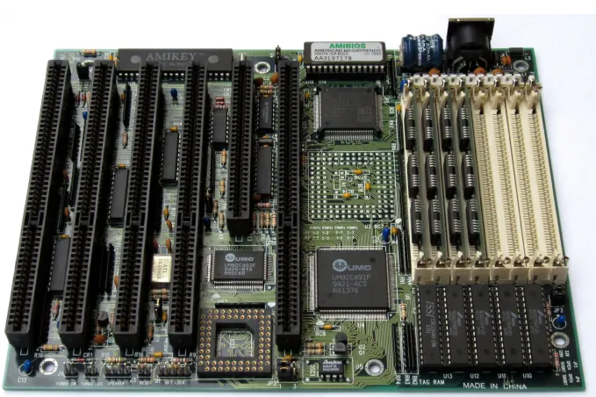

Slide 60
The ATX motherboard is similar to the Baby AT motherboard, except for a number of important enhancements.
Invented by Intel in 1995, it incorporates the first major change in the layout of PC motherboards to occur in years.
Most new systems come with the ATX motherboard form factor.

Slide 61
The motherboard

Slide 62
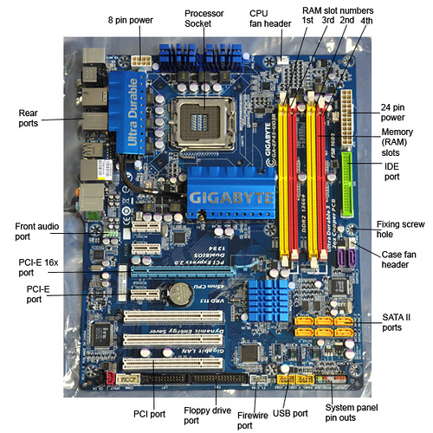

Slide 63
Expansion slots
An expansion slot is a socket on the motherboard that is used to insert an expansion card (or circuit board), which provides additional features to a computer such as video, sound, advanced graphics, Ethernet or memory.
An expansion slot is a connection point with a computer motherboard where an additional component can be added to the computer.
All computers have expansion slots that allow additional devices to be added.
Video cards, I/O cards, and sound cards are examples of components that are located in expansion slots.
The main function of the slot is to enable the card to interface and communicate with the motherboard, CPU, RAM, and other computer components.

Slide 64
Type of expansion slots in the motherboard
1. PCI Express (PCIe): This is the latest type of slot for input-output device connections. Video card
It offers a high bandwidth of data communication between the device and the computer. PCIe is the fastest type of expansion slot that is currently available.
2. PCI Peripheral Component Interconnect: they preceded the PCIe and they were a bit slower. Network card, SCSI, Sound card, Video card
3. AGP accelerated graphics port: they were designed for video and graphic types of cards. Video card
They had high data bandwidth compared to PCI. they support a direct connection between the device, CPU, and motherboard.

Slide 65
4. ISA industry standard architecture: This is the oldest type of expansion slot for old computers. Network card, Sound card, Video card
5. CPU sockets/slots
The slot where the CPU is connected to the motherboard is called a socket. When connecting the CPU to the socket ensure that you align the pins appropriately to avoid damage.
CPUs are only for a specific socket and motherboard. When you need to get a new CPU first check the type of CPU and ensure it is compatible with your motherboard. There are 2 main categories of CPU sockets available for connection.

Slide 66
6. Memory (RAM) slots
Most modern computers come with 2 to 4 slots that RAM can be connected.
They are 2 pairs that give 2 channels for data transmission.
For optimum use of RAM, you can fix 2 RAMs in the same channel.

Slide 67
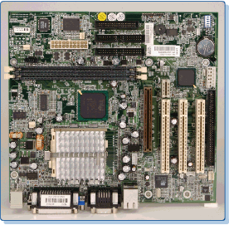

Slide 68
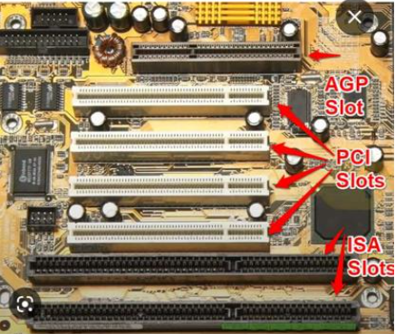
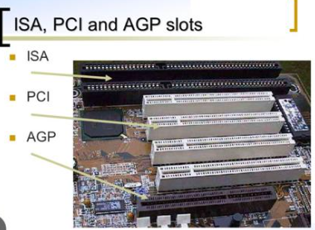
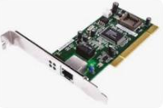

Slide 69
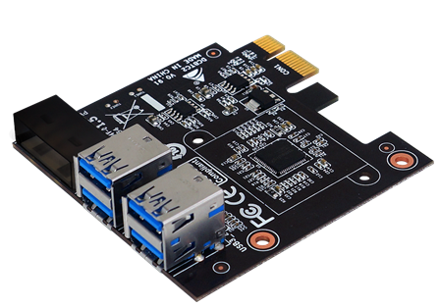
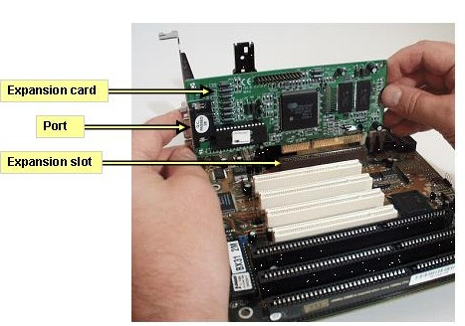
PCI: The PCI slot is the most common form of internal expansion for a PC.
Peripheral Component Interconnect: they preceded the PCIe and they were a bit slower

Slide 70
Common types of expansion cards
An expansion card is a functionality card that fits within a slot in the motherboard. The card is bought separately depending on the functionality to be added to the computer.
The following are some of the common expansion cards used in modern computers.
1. Sound card: this is a card that adds all capabilities to do with audio data.
2. Graphic/video card: the card supports high-definition video output. Users who deal with drawing, video editing, and other multimedia type of data can use the video card to enhance the output.

Slide 71
3. Network card (NIC card): it is a card for networking. The most common NIC card has ethernet ports that can be used to connect to the RJ45 connector. The computer comes with a NIC card pre-installed but you can add an extra one. Read more on the types, functions, and components of the network card in this other article.
4. Wireless /WiFI card: most desktop computers don’t have wireless capabilities. Wireless cards enable the computer to send and receive wireless signals. The card comes with a small external antenna to send and receive signals.

Slide 72
5. Storage card: it is a card that can be added to allow a solid-state type of storage device to be added to the computer. They are used mostly to add an SD card and flash memories.
6. Modem card: the card was used in old computers to convert analog signals to digital and vice versa. In most of today’s computers, the capability is inbuilt within the mainboard of the computer.
7. USB card: this is used to add more USB ports to the computer.
8. TV Card: the card allows the user to convert the computer into a TV. they were mostly used before digital computers become common.
9. Interface card: this is a card that carries many types of ports together. It offers an interface to connections such as USB, HDMI,…...

Slide 73
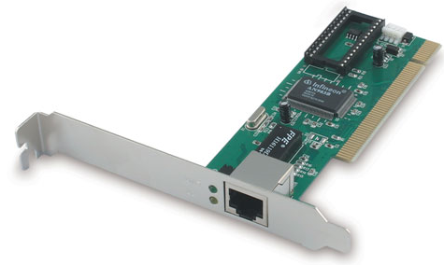
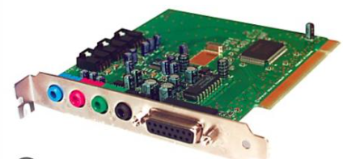
Difference between expansion slots and expansion cards
An expansion slot is a port where a card can be fixed while an expansion card is a circuit board that is fixed into a port (slot) to add functionality. The slot is the female port while a card is a male port.
Sound card schema: NIC

Slide 74
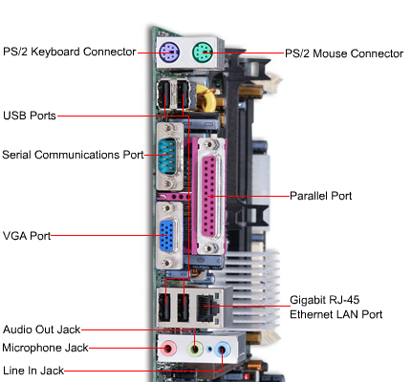

Slide 75
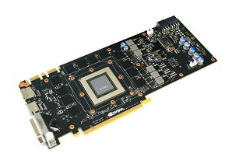
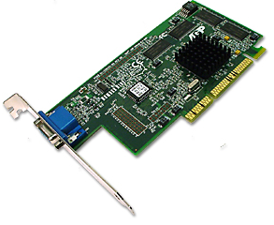
Video cards
The video card or video adapter, as shown in Figure below, is the interface between the computer and monitor. The video card tells the monitor which pixels to light up, what color the pixels should be, and the intensity of the color.

Slide 76
I/O ports
All peripheral devices that connect to the computer such as printers, scanners, and so on, use connectors on the back of the computer known as I/O ports. An I/O port is a pathway into and out of the computer. There are different types of ports on the computer that serve different purposes.
Serial Ports:
A serial port is a male port that can only send one bit of data at a time
A serial port can be used to connect devices that use a serial interface such as a modem, scanner, mouse, etc.
A serial port transmits one data bit at a time.

Slide 77
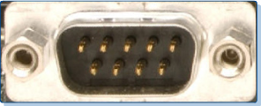
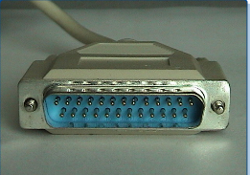
Figure below shows a DB-9 (9-pin) male connector used on most new computers for the serial ports.
Older printers use a larger, 25-pin connector for the serial port interface as shown in Figure below.

Slide 78
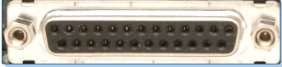
Parallel Ports
A parallel port is a socket on the computer that is used to connect newer printers or other peripheral device such as a portable hard disk, tape backup, scanner, or a CD-ROM.
The parallel port contains eight lines for transmitting an entire byte (8 bits) across the eight data lines simultaneously.
Parallel Port is a female port that can send several bits at the same time.
Parallel Port transmits multiple bits at a time.
Figure below shows a female DB-25 parallel port.

Slide 79
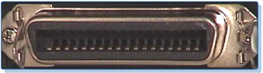
Figure below shows the 36-pin female port typically found on the printer.

Slide 80
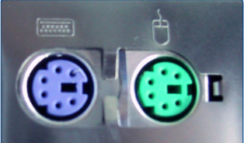
PS/2 Ports/6-pin Mini Din, 5-Pin DIN
PS/2 keyboard or PS/2 mouse ports are used to connect the PC to its keyboard and mouse. Though both ports look identical, the mouse and keyboard ports are not interchangeable. Usually both ports are color coded or labeled to avoid any confusion as shown in Figure below.

Slide 81
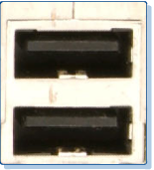
The cable that connects the PS/2 keyboard or mouse uses a PS/2 type connector, also known as a 6-pin mini DIN connector.
The PS/2 (or 6-pin mini-DIN) has become very popular since its introduction by IBM in 1987 with the IBM PS/2.
Universal Serial Bus (USB)
The Universal Serial Bus (USB) is an external port, Figure above, that allows the user to connect external PC peripherals, including USB keyboards, mice, printers, modems, scanners, and external disk drives.

Slide 82
Floppy drives
A floppy disk drive (FDD) magnetically reads and writes information onto floppy diskettes, which are a form of removable storage media.
The hard drive
A hard disk drive shares many physical and operational characteristics with the floppy disk drive.
It has a more complex design and provides a greater speed of access.
The HDD has a much larger storage capacity than the floppy for long-term storage. It stores programs and files, as well as the operating system.
Typically, the HDD is an internal drive that cannot be removed from the computer.

Slide 83
Thank you for your kind attention!!
END OF CHAPTER ONE!!!

